Slide 1
Enhancer Prediction from ATAC-Seq and Sequence Data Features
Sumaira Zaman
PI: Duygu Ucar
Summer Student Program 2015
Notes:
Good afternoon everyone, my name is sumaira zaman and I am an undergraduate at UCONN studying biomed engr. This summer I worked in Duygu Ucar’s Lab for “Title”

Slide 2
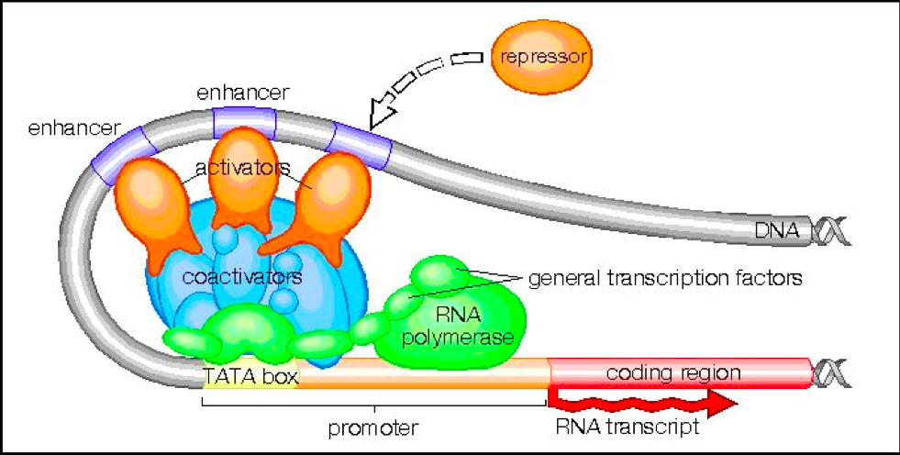
Enhancers
Enhancers determine transcription rate of a gene by interacting with the gene promoter.
Enhancer repertoire is known to be highly specific to cell type and developmental stage.
Recent studies have identified that majority of disease-causing Single Nucleotide
Polymorphisms (SNPs) for common human diseases lie in enhancer sequences.
Current efforts to identify enhancer sequence and activity include pairing deep
sequencing technology with molecular techniques.
Notes:
The figures depict the transcription process where protein coding regions of DNA are being transcribed into RNA. However, surrounding regulatory genomic region such as enhancer can alter the rate of tx by interacting w/ gene promoters with the help of TF (activators and repressors). The sequences to which TF binds are known as TF binding sites.
to interrogate chromatin accessibility (DNase-seq) or to assess histone modification/DNA binding protein patterns (ChIP-seq). Problems with Dnase-seq and ChIP-seq include large cell number and large amount of library prep.

Slide 3
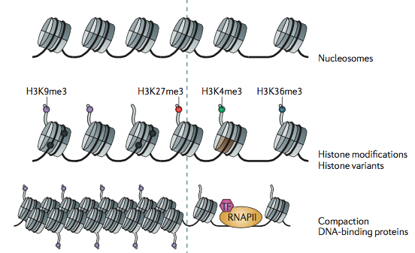
Chromatin & Epigenetics
Zhou, Vicky W., Alon Goren, and Bradley E. Bernstein. "Charting Histone Modifications and the Functional Organization of Mammalian Genomes." Nat Rev Genet Nature Reviews Genetics (2010): 7-18.
Notes:
DNA has it’s own 3-D structure known as the nucleosome. They have amino acid tails which go through chemical modifications known as histone modification. These modifications are associated with enhancer activity such as H3K4me1 and H3k27ac. Also, the tightness of the DNA around nucleosomes determines active and inactive regions. Therefore, chromatin structure and histone marks are very informative for predicting functional states such as enhancers.

Slide 4
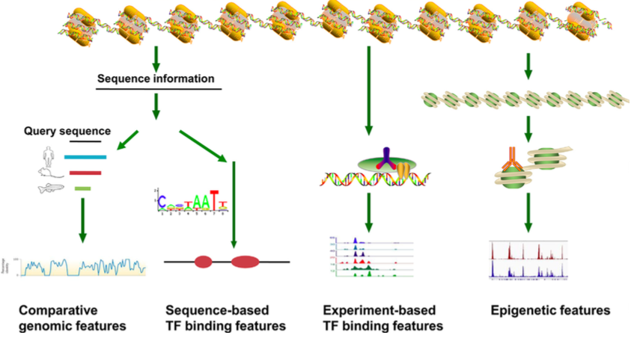
Previous Studies of Enhancer Prediction
Conservation score Transcription Factor H3K4me1
GC content Binding Sites H3K27ac
Wang, Chengqi, Michael Q. Zhang, and Zhihua Zhang. "Computational Identification of Active Enhancers in Model Organisms." Genomics, Proteomics & Bioinformatics 11 (2013): 142-50.
Notes:
Efforts to computationally predict enhancer (integrative data) and these are the most frequently used data sets in these methods
TF Binding features = two groups, experimentally determine and sequence determine where, similarity of sequence to know TF binding motif
Epigenetic features such as histone modification is another sign for the activity of enhancers, Histone mark data is generated with ChIP-seq and with histone mark data we can predict chromatin states using a program called chromHMM. ChromHMM is an algorithm that utilizes Hidden Markov Model (HMM), a statistical model. Histone marks can be generated with Chip-Seq and data can be analyzed by ChromHMM to predict chromatin states. However ChromHMM requires a lot of ChIP-Seq.

Slide 5
ATAC-seq
Assay for transposase accessible chromatin or ATAC-seq is an innovative method for investigating open chromatin regions.
Buenrostro, Jason D, Paul G Giresi, Lisa C Zaba, Howard Y Chang, and William J Greenleaf. "Transposition of Native Chromatin for Fast and Sensitive Epigenomic Profiling of Open Chromatin, DNA-binding Proteins and Nucleosome Position." Nature Methods 10.12 (2013): 1213-218.
We hypothesize that cell type specific enhancers can be identified using ATAC-seq based epigenetic features in conjunction with comparative DNA sequence features.
Notes:
So what it does is, it integrates the Tn5 transposase adaptors into regions that are accessible and what that means is Tn5 will not not be able to insert itself into regions where there is steric hindrance
#entire assay and library construction can be carried out in a simple protocol involving Tn5 insertion followed by PCR

Slide 6
Methodology & Data
CD4+ T-cells ChromHMM States
ATAC-seq Feature Extraction
- Peak Length
- Peak Score
- Read Count
Sequence Feature Extraction
- Conservation Score
- GC content
- Transcription Factor Motifs
Classification Model
Validation
Notes:
So the methodology of our study can be summarized with this flow. was Using CD4+ T-cells
Peak is a region that is significantly enriched in atac seq reads which represent potential open chromatin sites identified by MACS2
Validation = comparison of chromHMM states

Slide 7
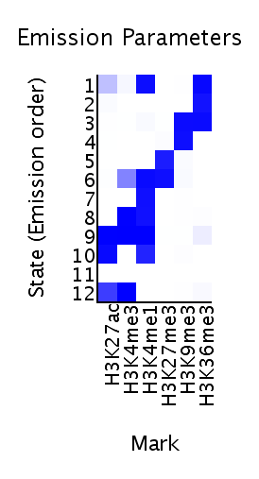
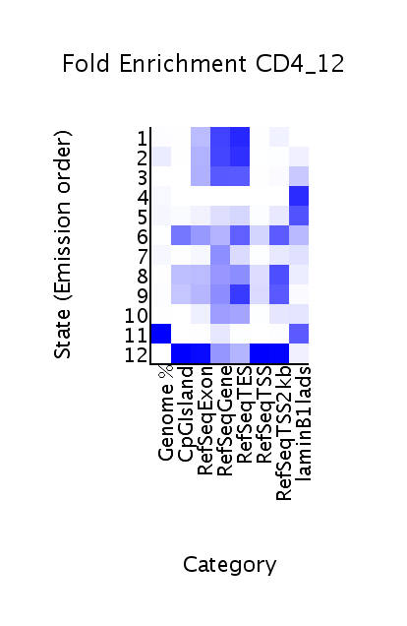
ChromHMM Output
Elongation
Transcription
ZNF
Heterochromatin
Repressed Polycomb
Poised Promoter
Enhancer
Strong Promoter
Strong Enhancer
Strong Enhancer
Low Signal
Strong Promoter
Notes:
We did a chromHMM analysis on the public CD4+ data
computing state enrichments for large-scale functional datasets
Define Regulatory and non-regulatory.

Slide 8
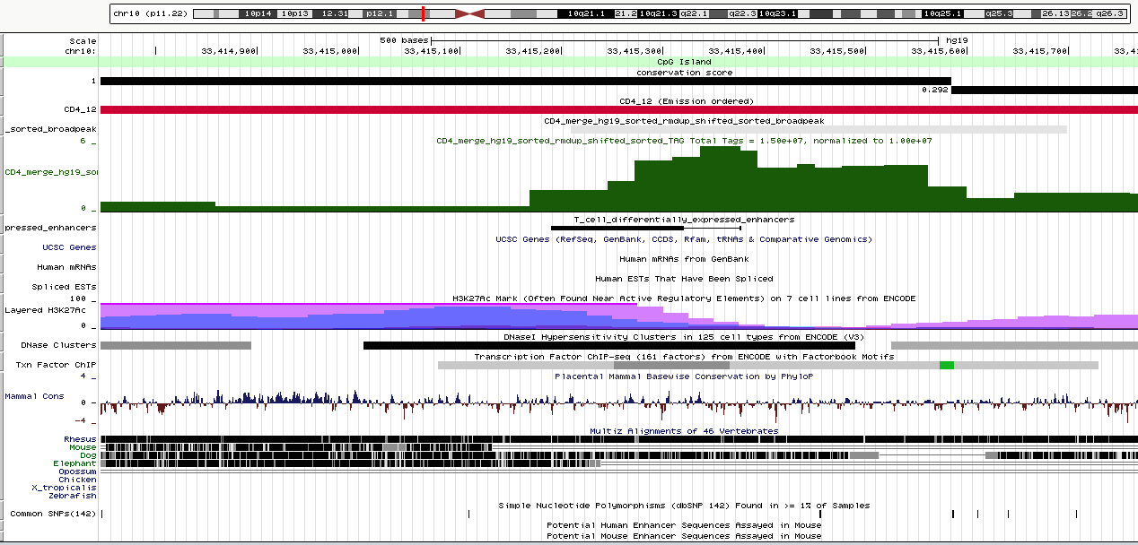
Enhancer Region (Regulatory)
Notes:
What a regulatory region (promoter) would look like. We can see it is highly conserved, it is categorized as a CpG island with high GC content. It is open and accessible by Tn5 hence the broad and large peak.
Try to find a better region
Boxes and arrows

Slide 9
Regulatory Vs. Non-Regulatory Regions
Regulatory region
(enhancer)
Conservation score = 1
ChromHMM state
ATAC-seq peak
FANTOM5 enhancer
Non-Regulatory region (transcription)
Conservation score = 0.495
ChromHMM state
ATAC-seq peak
FANTOM5 enhancer
Notes:
Peak is barely existant

Slide 10
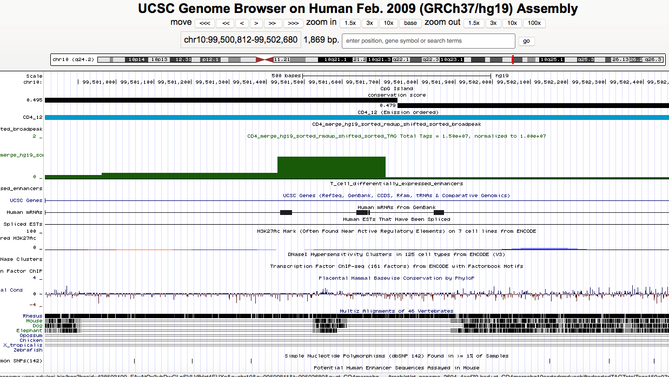
Transcriptional Region (Non-Regulatory)
Notes:
The above figure shows a non regulatory region, transcription. It is not highly conserved, not categorized as a CpG island, low GC content, not a very high peak.

Slide 11
Data Matrix
Chr | Chr Start | Chr End | ATAC-seq Features |  |  | Sequence Features |  |  | State
 |  |  | Peak Len. | Peak Score | Read Count | Consv. Score | GC Content | TFBS Count
1 | 757,704 | 757,992 | 288 | 0.2947 | -0.8205 | -0.4163 | -2.2063 | -0.3967 | 10
1 | 779,688 | 780,139 | 451 | 0.4238 | -0.3988 | -0.3181 | -1.4825 | -0.3967 | 10
Total number of ATAC seq peaks = 85,350
Peaks overlap with enhancer states = 24,251
Notes:
Data preprocess, and feature extraction and this matrix will be used Only show bottom matrix and add states
# of promoters = 6082 + 8081 = 14,163
46936 all others

Slide 12
Two Stage Classifier
Promoters
Regulatory Regions
All 12 ChromHMM states
Enhancers
Non-Regulatory Regions
Classifiers used:
Linear Discriminant Analysis (LDA)
Naïve Bayes
Decision Trees
Notes:
Different classifiers used.
Describe the Discriminant analysis - to find a linear combination of features that separates two or more classes of objects. The resulting combination may be used as a linear classifier,

Slide 13
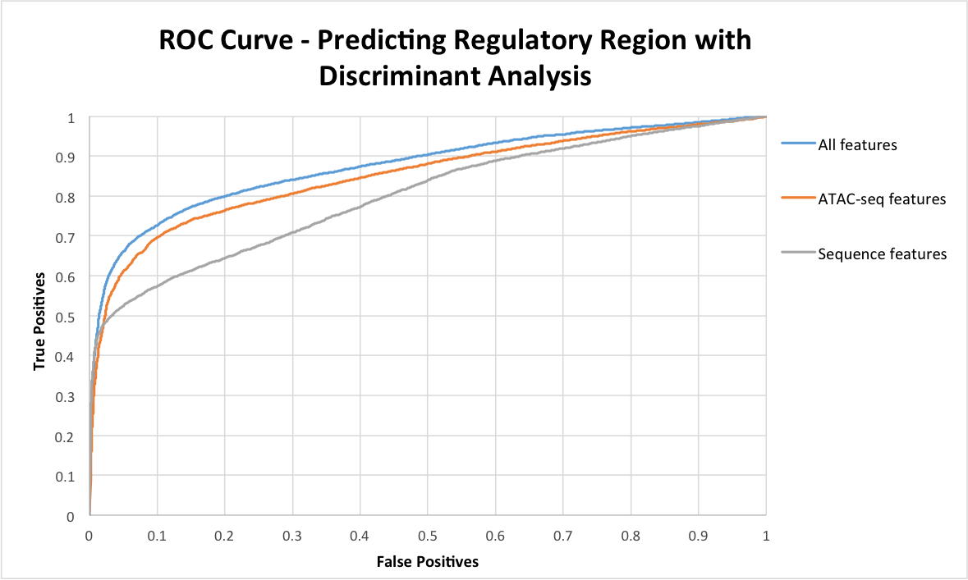
0.8751
0.8504
0.7997
Notes:
Receiver operating Characteristic curve

Slide 14
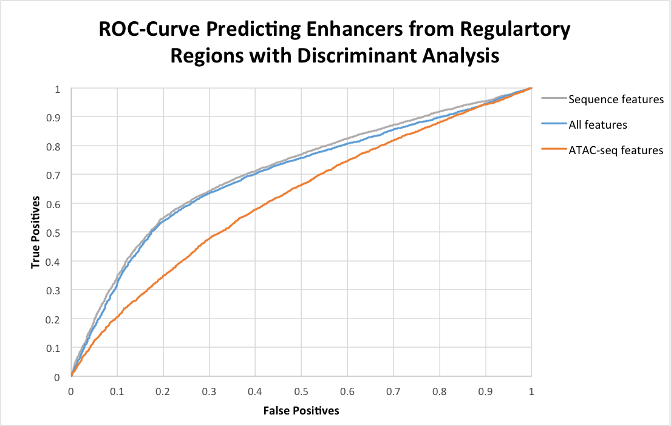
0.7114
0.6975
0.6171
Notes:
So, overall the nested classifier’s accuracy for correctly identifying enhancer regions is 62%.

Slide 15
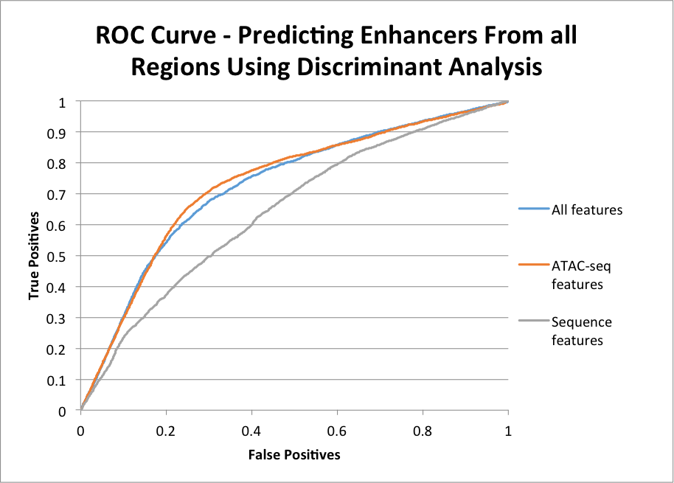
0.7325
0.7261
0.6442
Notes:
Why is ATAC-seq alone doing better than all?

Slide 16
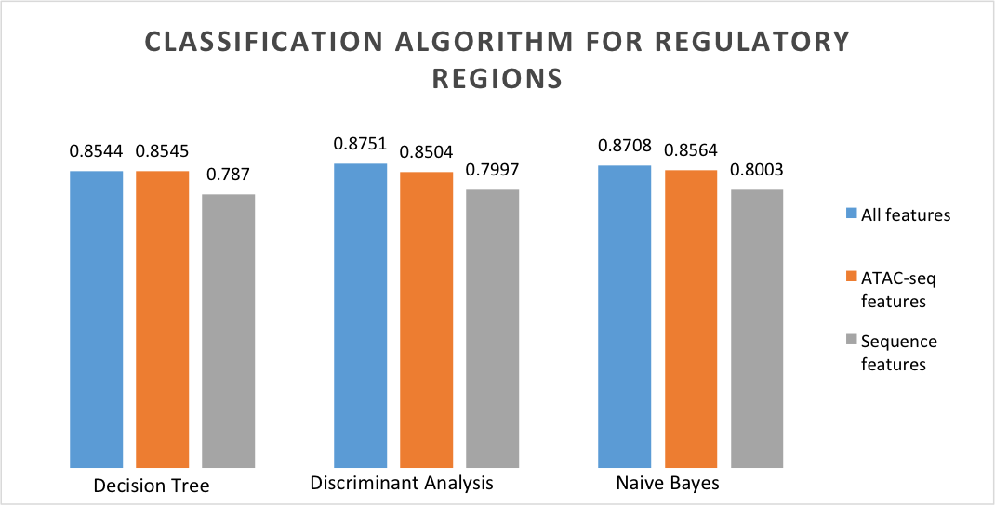
Predicting Regulatory Regions with Different Algorithms

Slide 17
Predicting Enhancer within Regulatory Regions using Different Algorithms

Slide 18
Predicting Enhancers with Different Algorithms

Slide 19
Concluding Remarks
We predicted enhancers with ATAC-seq datasets with reasonable accuracy, 73%.
Data integration increases the predictive power of the algorithm.
Future work
Further data integration
Utilization of other classification algorithms
Using additional genomic features
Notes:
The following conclusions can be made,
We hope to integrate more data such determining which TF are cell specific and associated with active regions
Other algorithms such as SVM.
Remove exons because they are highly conserved and we are namely not interested in them

Slide 20
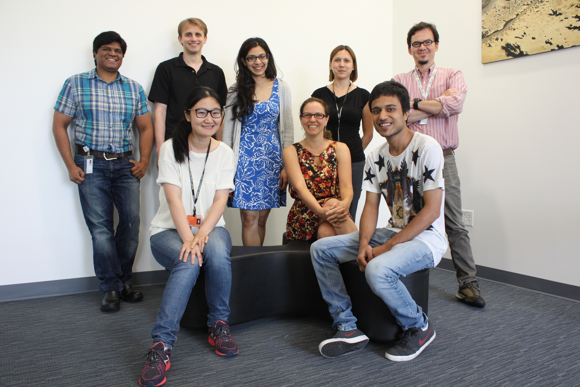
Acknowledgements
PI: Duygu Ucar
Mentors: Asli Uyar & Eladio Marquez
Jackson Lab Summer Student Program
National Science Foundation – Research Experience for Undergraduate

